Slide 1

Prediction and Analysis of Customer Buying Behaviour

Slide 2
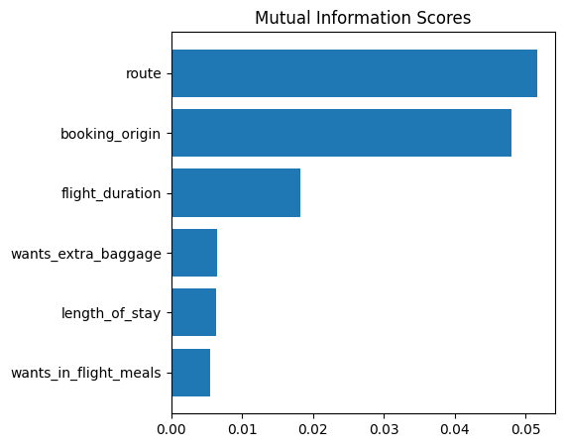
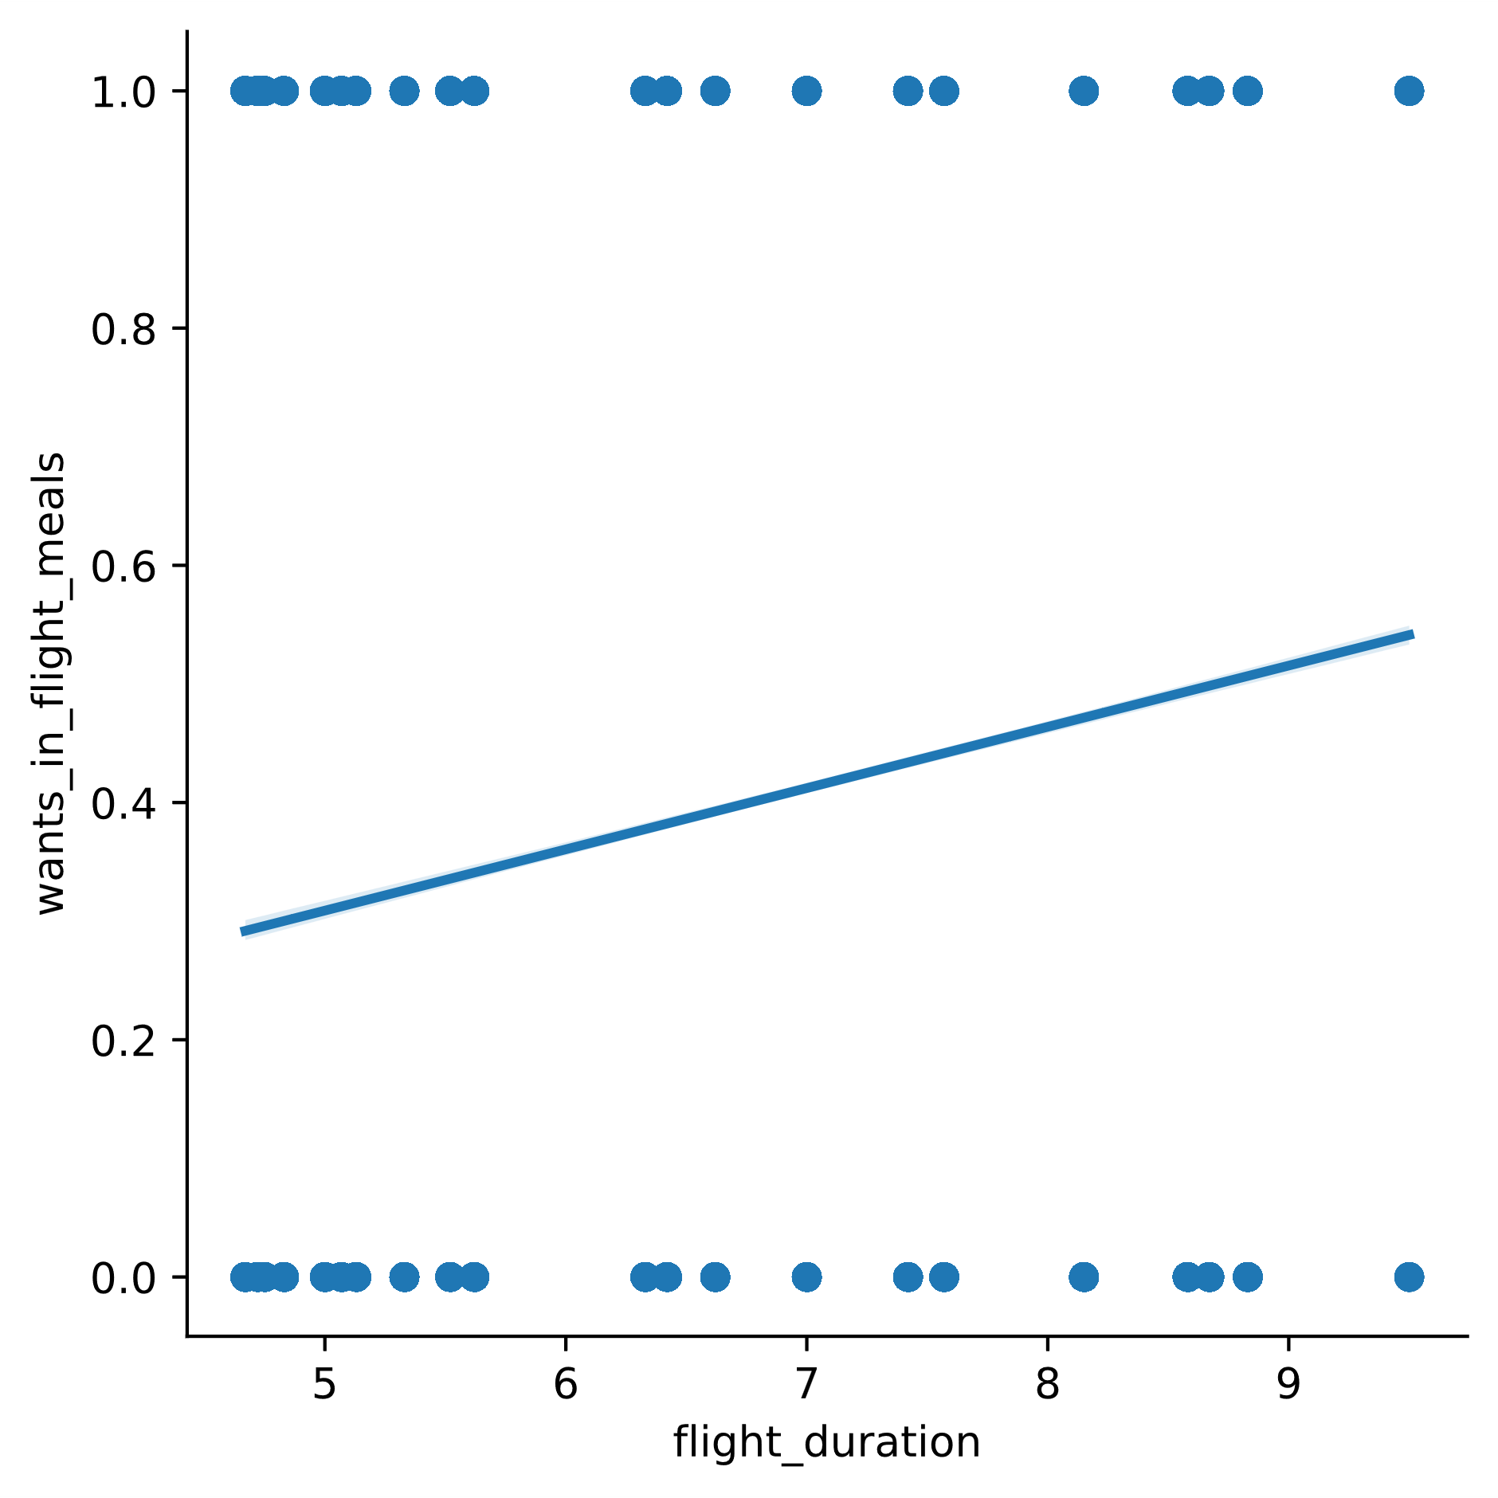
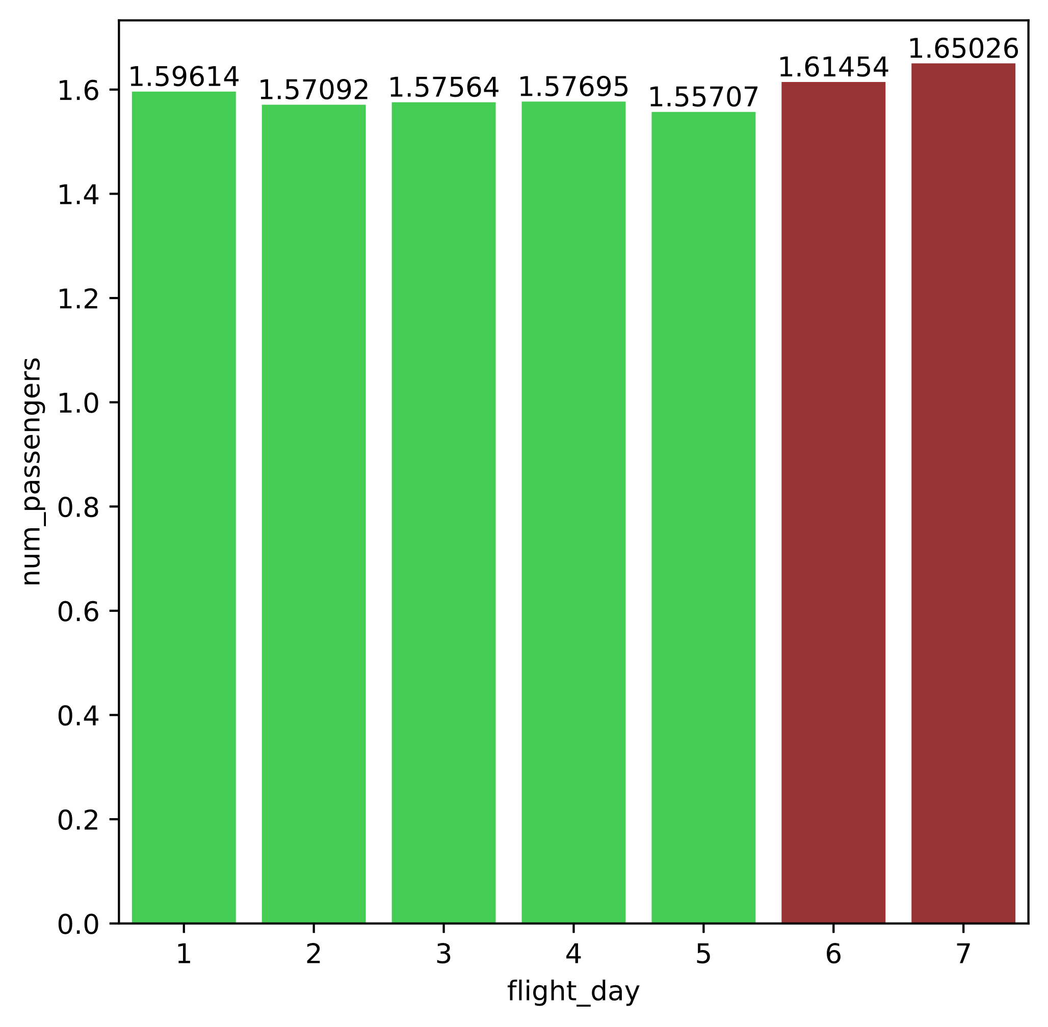
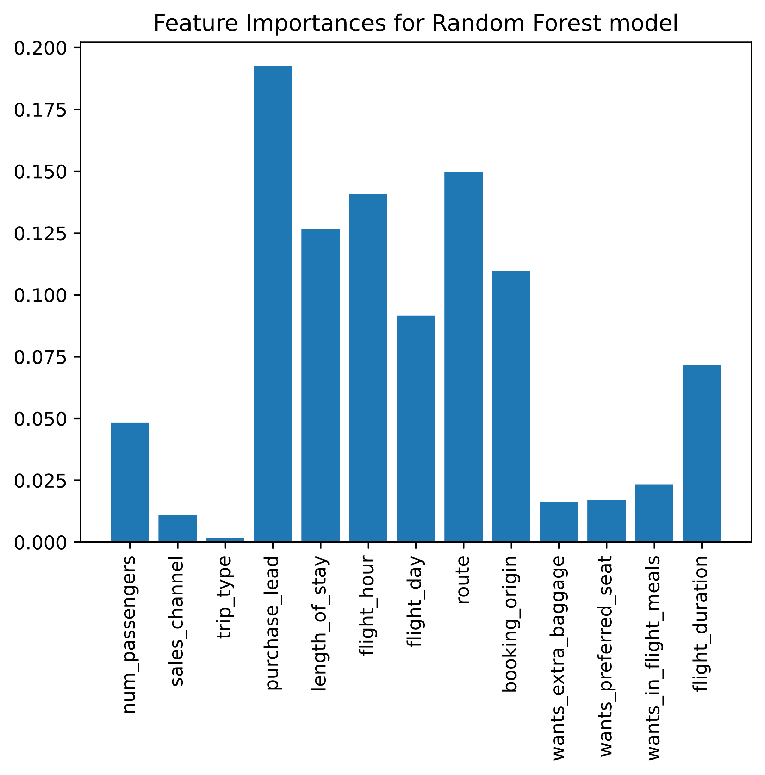
Top 5 features which determined booking completion:
Route
Booking Origin
Flight Duration
Needs Extra Baggage
Length of Stay
Wants in-flight meals
Also, with the increase in the flight duration, the probability of a passenger opting for in-flight meal increases. So long-haul flights should definitely offer passengers with quality food at low costs.
From this graph we can infer that the average number of passengers booking flights is more during the weekends i.e., on Saturdays and Sundays. So, flights rates should be set accordingly during these days.
Predictive Model Performance Analysis
We used a Random Forest classifier model and a Logistic Regression model to predict customer buying behaviour. These are how the models performed:
Random Forest: Accuracy - 84.64%
Logistic Regression: Accuracy – 85.31%
‘purchase_lead’ turned out to be the most important feature.

